Slide 1
Lecture 10

Slide 2
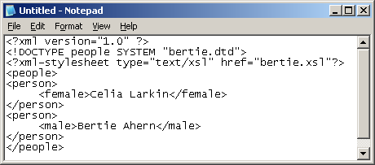
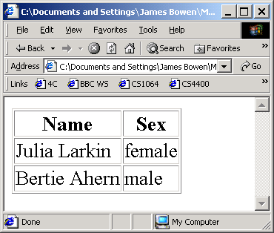
Back to the table example
We can now return to considering in detail the first XSLT style-sheet we saw
  The one which, when applied to the XML document below-left produces the HTML document below-right
  It is repeated on the next slide and then considered in detail

Slide 3
The XSL style-sheet for the TABLE example
<?xml version="1.0"?>
<xsl:transform
xmlns:xsl="http://www.w3.org/1999/XSL/Transform” version="1.0">
<xsl:template match="/">
<html><body><table rules="all">
<thead><tr><th>Name</th><th>Sex</th></tr></thead>
<tbody>
<xsl:apply-templates/>
</tbody></table></body></html>
</xsl:template>
<xsl:template match="person">
<tr><xsl:apply-templates/></tr>
</xsl:template>
<xsl:template match="male">
<td><xsl:value-of select="."/></td><td>male</td>
</xsl:template>
<xsl:template match="female">
<td><xsl:value-of select="."/></td><td>female</td>
</xsl:template>
</xsl:transform>

Slide 4
The table example (contd.)
In this case, our style-sheet consists of four templates:
  one template, whose match attribute has the value “/”, is satisfied when it finds the root node of the tree corresponding to the XML document.
    It then produces the main skeleton of the resultant HTML document and calls other templates to transform its children elements.
  The template whose match attribute has the value “person” is satisfied when it finds a person element.
    It produces a <tr> and </tr> tag-pair, in-between which it calls templates to transform its children elements

Slide 5
The table example (contd.)
  The template whose match attribute has the value “male” is satisfied when it finds a male element.
    It produces a <td> tag, followed by the content of the male element, followed by the following sequence of HTML, that is </td> <td>male</td>
  The template whose match attribute has the value “female” is satisfied when it finds a female element.
    It produces a <td> tag, followed by the content of the female element, followed by the following sequence of HTML, that is </td> <td>female</td>

Slide 6
Another Example
Consider the following XML document
<?xml version="1.0" ?>
<?xml-stylesheet type="text/xsl" href="bertie3.xsl"?>
<people>
  <person>
    <sex>female</sex>
    <age>21</age>
    <name>Julia Larkin</name>
  </person>
  <person>
    <sex>male</sex>
    <age>22</age>
    <name>Bertie Ahern</name>
  </person>
</people>

Slide 7
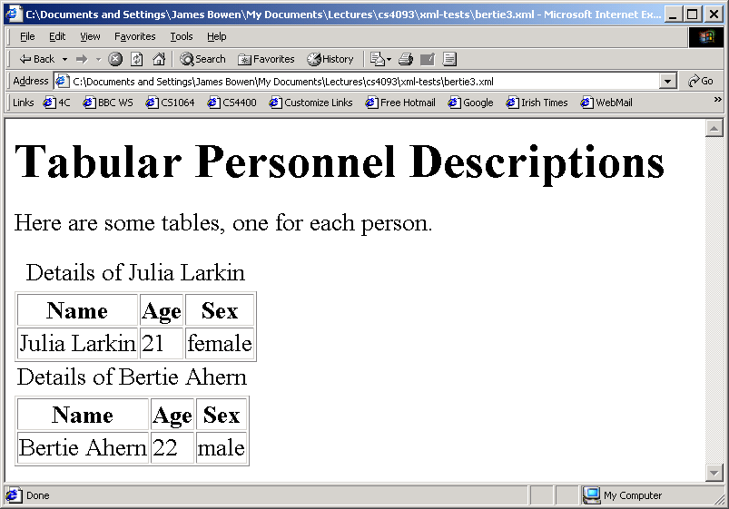
Another example (contd.)
Suppose we wanted to render it as in the image below

Slide 8
Another example (contd.)
Here is the stylesheet:
<?xml version="1.0"?>
<xsl:transform xmlns:xsl="http://www.w3.org/1999/XSL/Transform" version="1.0">
<xsl:template match="/">
<html><body>
<h1>Tabular Personnel Descriptions</h1>
<p>Here are some tables, one for each person.</p>
<xsl:apply-templates/></body></html>
</xsl:template>
<xsl:template match="person">
<table rules="all">
<caption> Details of <xsl:value-of select="./name"/> </caption>
<thead><tr><th>Name</th><th>Age</th><th>Sex</th></tr></thead>
<tbody><tr><td><xsl:value-of select="./name"/></td>
<td><xsl:value-of select="./age"/></td>
<td><xsl:value-of select="./sex"/></td></tr></tbody>
</table>
</xsl:template>
</xsl:transform>

Slide 9
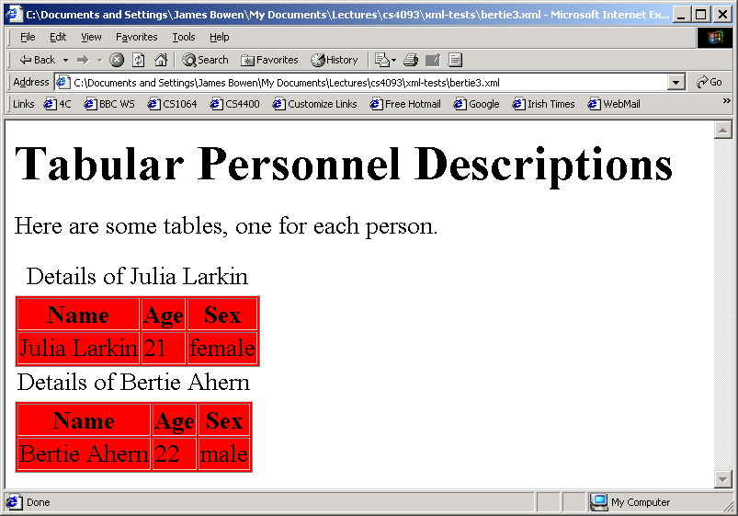
Another example (contd.)
Suppose we wanted also wanted to embed a CSS style-sheet in the XSLT style-sheet, as below

Slide 10
Another example (contd.)
Here is the XSLT stylesheet:
<?xml version="1.0"?>
<xsl:transform xmlns:xsl="http://www.w3.org/1999/XSL/Transform" version="1.0">
<xsl:template match="/">
<html>
<head> <style> <![CDATA[ table {background-color:red} ]]> </style> </head>
<body> <h1>Tabular Personnel Descriptions</h1>
<p>Here are some tables, one for each person.</p>
<xsl:apply-templates/></body></html>
</xsl:template>
<xsl:template match="person">
<table rules="all">
<caption> Details of <xsl:value-of select="./name"/> </caption>
<thead><tr><th>Name</th><th>Age</th><th>Sex</th></tr></thead>
<tbody><tr><td><xsl:value-of select="./name"/></td>
<td><xsl:value-of select="./age"/></td>
<td><xsl:value-of select="./sex"/></td></tr></tbody>
</table>
</xsl:template>
</xsl:transform>

Slide 11
A word of warning
There appears to be a bug in MSIE 6.0
This may confuse you when you are experimenting with XSLT
  sometimes an error in you XSLT will cause MSIE to give you an error message
  after you correct the error, you will still get the error message, unless you try a new window
  that is, MSIE fails to refresh properly after XML errors
This bug does not arise in Mozilla
  I have not tried other browsers

Slide 12
XPath

Slide 13
XPath is a W3C standard
It is a syntax for identifying parts of an XML document
It uses path expressions to navigate around XML documents
It provides a library of more than 100 functions for building these path expressions
We have seen that XPath is used in XSLT
It is also used in other technologies, such as XQuery and XPointer

Slide 14
XPath nodes
XPath views an XML document as a tree of nodes
There are seven kinds of node:
  element,
  attribute,
  text,
  namespace,
  processing-instruction,
  comment, and
  document (root) nodes.

Slide 15
Example XML document:
<?xml version="1.0"?>
<catalogue>
<book>
<title lang=”fr">Les Miserables</title>
<author>Victor Hugo</author>
<year>1862</year>
<price>250.99</price>
</book>
</catalogue>
In this document
  <catalogue>, <book>, <title>, <author>, <year>, <price>, are element nodes
  lang=”fr" is an attribute node
  Les Miserables is a text node
  <catalogue> is the root element in the XML document but it is not the root node of the XPath tree view of the document
  the root node is a virtual node which contains the root element
  Note: if you look on the web, you will find that many discussions of Xpath fail to make this distinction between the root element of an XML document and the root node of the Xpath tree which corresponds to the XML document

Slide 16
XPath path
An XPath path is a bit like a directory path in Unix/Linux
  a Unix directory path identifies part of the directory tree
  An Xpath path identifies part of a tree corresponding to an XML document
An Xpath path can be either an absolute path or a relative path
  an absolute path is one which starts with the single character /
  a relative path is one which starts from the current context node
    the root node is the default context node
    but other nodes can become the current context node at various times

Slide 17
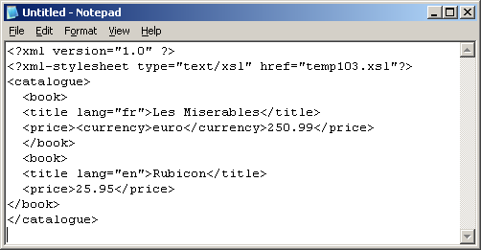
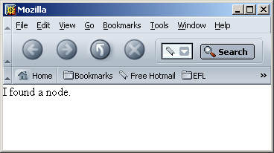
Xpath examples: locating the root node
<?xml version="1.0"?>
<xsl:transform version="1.0" xmlns:xsl="http://www.w3.org/1999/XSL/Transform">
<xsl:template match="/">
<body>I found a <xsl:value-of select="name()"/> node.</body>
</xsl:template>
</xsl:transform>

Slide 18
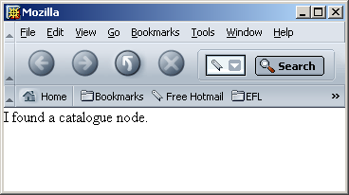
Xpath examples: locating the root element
<?xml version="1.0"?>
<xsl:transform version="1.0" xmlns:xsl="http://www.w3.org/1999/XSL/Transform">
<xsl:template match="/catalogue">
<body>I found a <xsl:value-of select="name()"/> node.</body>
</xsl:template>
</xsl:transform>

